Slide 1


VIRTUAL VOICE ASSISTANT
INSTRUCTOR: PROF. DHRUVI GOSAI
USING PYTHON
PRESENTED BY:
20DCE013: SANKET BHIMANI
20DCE019: YATHARTH CHAUHAN

Slide 2
AGENDA
Introduction
How does an intelligent voice assistant work?
Purpose of system
Dataflow diagram
Use case diagram
Python Libraries
Existing system and proposed system
Future Functionalities:
Hardware And Software Requirements
Limitations
Preview
References
Conclusion

Slide 3
INTRODUCTION
Python Speech Recognition: Recognition speech is the act of translating spoken words into text. Python supports many speech recognition engines such as Google Speech Engine, Microsoft Bing Voice Recognition, and many others.
It is a combination of several different technologies: voice recognition, voice analysis and language processing.
It is completely developed using one of the most powerful language python.

Slide 4
HOW DOES AN INTELLIGENT VOICE ASSISTANT WORK?
User asks a voice assistant to perform a task.
The natural language audio signal is converted into digital data that can be analyzed by the Application.
Compared with a database of the software using an innovative algorithm to find a suitable answer.
This database is located on distributed servers in cloud networks. For this reason ,it must have a reliable Internet connection.

Slide 5
PURPOSE OF SYSTEM
Purpose of virtual assistant is to being capable of voice interaction, music playback, making to-do lists, setting alarms, streaming podcasts, playing audiobooks, and providing weather, traffic, sports, and other real-time information, such as news.
Virtual assistants enable users to speak natural language voice commands in order to operate the device and its apps.
the main purpose of A.I machines is that it can perform human tasks with the same efficiency or even more efficiently than humans.

Slide 6
DATAFLOW DIAGRAM
D.F.D - 1
Personal voice assistant
Speech to Text
Voice
Action
User
Computer
Response
Voice output
Text to speech

Slide 7
USE CASE DIAGRAM
D.F.D - 2
Play Music
Wikipedia
Stopwatch
Input Voice
Camera
User
Open System Apps
Date-Time

Slide 8
PYTHON LIBRARIES
We used following modules and libraries
pyttsx3: It is a python library which converts text to speech.
SpeechRecognition: It is a python module which converts speech to text.
pywhatkit: It is python library to send WhatsApp message at a particular time with some additional features.
Datetime: This library provides us the actual date and time.
Wikipedia: It is a python module for searching anything on Wikipedia.

Slide 9
PYTHON LIBRARIES
We used following modules and libraries
Smtplib: Simple mail transfer protocol that allows us to send mails and to route mails between mail servers.
pyPDF2: It is a python module which can read, split, merge any PDF.
Pyjokes: It is a python libararies which contains lots of interesting jokes in it.
Webbrowser: It provides interface for displaying web-based documents to users.

Slide 10
EXISTING SYSTEM V/S PROPOSED SYSTEM
Existing System | Proposed System
Usage statistics and user data are sent to the developer | Does not collect any user data
Not a free Software | Free Software
User cannot edit or change the modules | User can edit and add new modules
 | lightweight
 | Simple User interface

Slide 11
FUTURE FUNCTIONALITIES
Send Emails
Read Pdf
Send Text On WhatsApp
Give Weather Forecast
Give News
Call Feature
Give Desktop Reminders Of Your Choice
Some Basic Conversation

Slide 12
HARDWARE AND SOFTWARE REQUIREMENTS
Hardware Requirements :
Pentium-pro processor or later.
RAM 512MB or more.
Software Requirements :
Windows 7(32-bit) or above.
Python 2.7 or later
Chrome Driver

Slide 13
LIMITATIONS
Security is somewhere an issue, there is no voice command encryption in this project.
Background voice can interfere Misinterpretation because of accents and may cause inaccurate results.
It cannot be called externally anytime like other traditional assistants like Google Assistant can be called just by saying, “Ok Google!”

Slide 14
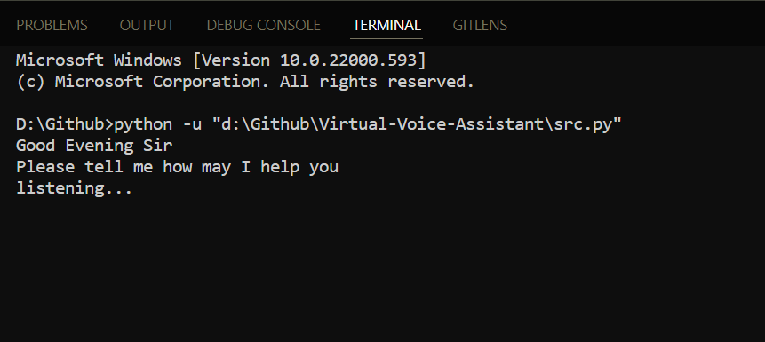
Starting of Program

Slide 15
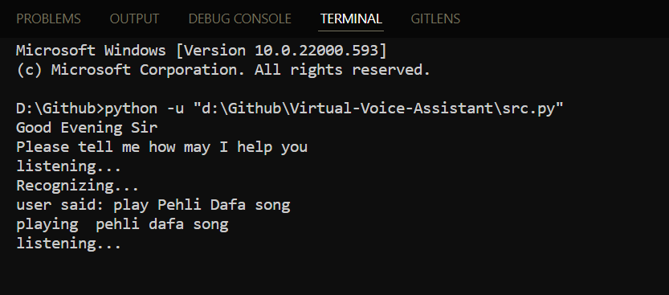
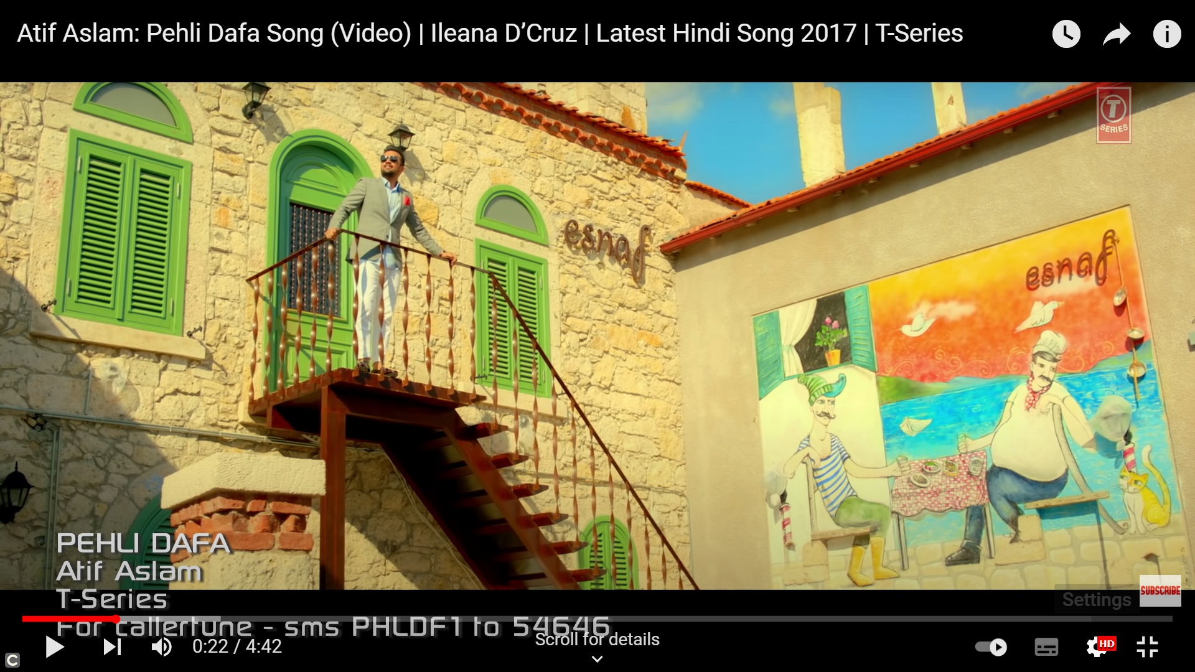
Give a Play Song Command

Slide 16
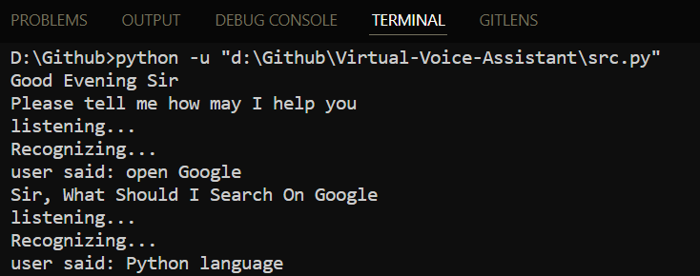
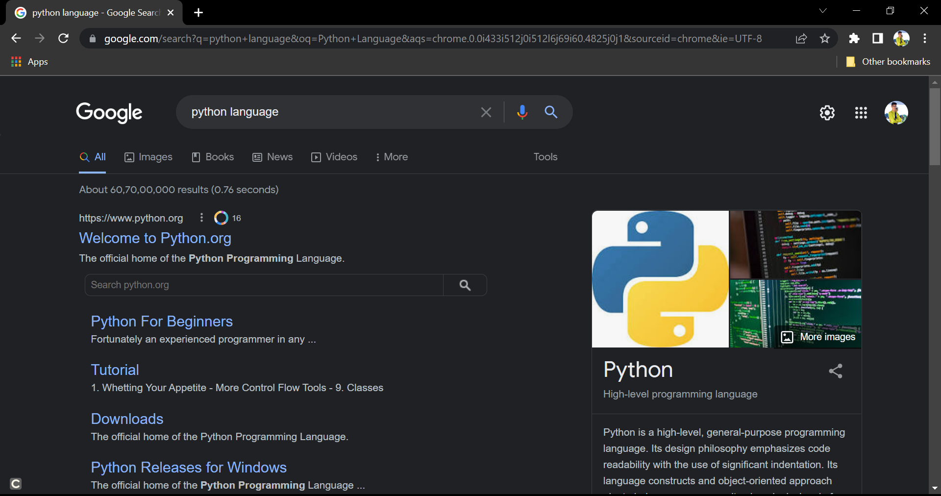
Search On Google Command

Slide 17
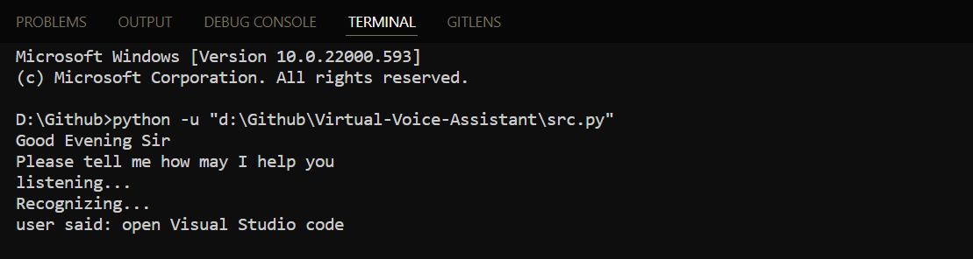
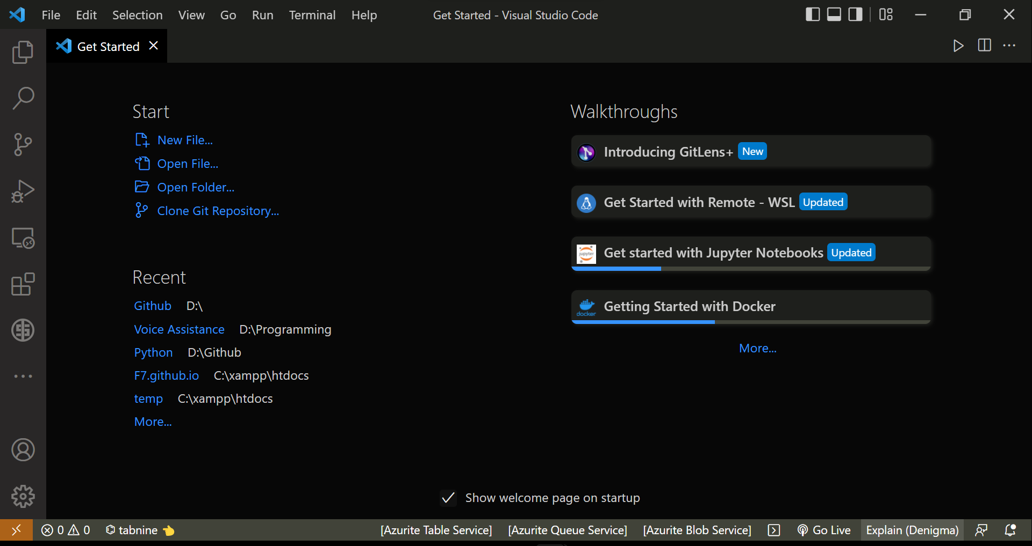

Open System App

Slide 18
REFERENCES
https://docs.microsoft.com/en-us/azure/cognitive-services/speech-service/index-voice-assistants
https://medium.com/analytics-vidhya/a-guide-to-your-own-a-i-voice-assistant-using-python-17f79c94704

Slide 19
CONCLUSION
It is a very helpful voice assistant without any doubt as it saves time of the user by conversational interactions, its effectiveness and efficiency.
It can be designed to minimize the human efforts to interact with many other subsystems, which would otherwise have to be performed manually.
By achieving this, the system will make human life comfortable.

Slide 20
THANK YOU

